Slide 1
GAN based Covid-19 augmentation and multilabel CXR classification
Group 1
Notes:
Luca

Slide 2
Motivations
Adar et al. (18 March, 2018) : X-ray liver cyst classification using GAN augmentation
Covid-19 global event, sparked interest in Machine Learning community
Kaggle today: 30.242 notebooks and datasets related to Covid
Covidx5/Covid-net: Largest open dataset available at the time of research
Extremely imbalanced class labels (617 covid, 8851 normal, 6069 pneumonia)
Research Question: Can GANs generate representative Covid-19 CXR images?
Notes:
Luca

Slide 3
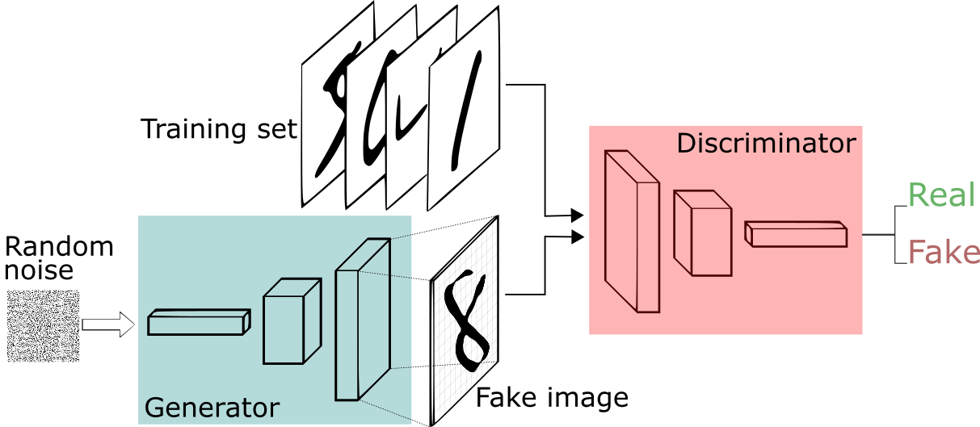
GAN - Generative Adversarial Network
Image source: https://2018.igem.org/Team:Vilnius-Lithuania-OG/Gan_Introduction
See how good they can be for yourself: whichfaceisreal.com
Notes:
What is a generative adversarial network. It is a combination of 2 networks that compete during training. The goal of the generator is to generate an image that will fool the discriminator into thinking that it a real image. The discriminators role is to tell real images apart from the fake ones. Training GANs tends to be tough because they learn the best when the capabilities of the discriminator and the generator remain closely matched.

Slide 4
Related work
Loey et al. (20 April, 2020) : 81.5% accuracy on 3-label classification, provided architecture for unconditional GAN but no detail on training. Extremely small initial dataset (69 covid-19 images only, 306 images total for train and test sets)
Waheed et al. (14 May, 2020) : 95% accuracy for binary classification using an ACGAN, small dataset (403 covid-19), low resolution GAN images (112x112x3), 2000 epochs over 5 hours
Zulkifley et al. (16 September 2020) : Conditional GAN (224x224) to augment minority label, used all data to train GAN, 5-fold cross validation, 3-label classification, 96.97% accuracy but no mention of train/test split
Problems: No quantitative GAN analysis, small datasets, potentially questionable test data usage
Notes:
Jakub After we started to work towards our goal and did more research we discovered that we were not the only ones with the idea of using GANs to generate synthetic data in the covid problem. An early paper from April used a very small dataset.

Slide 5





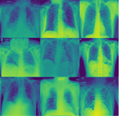
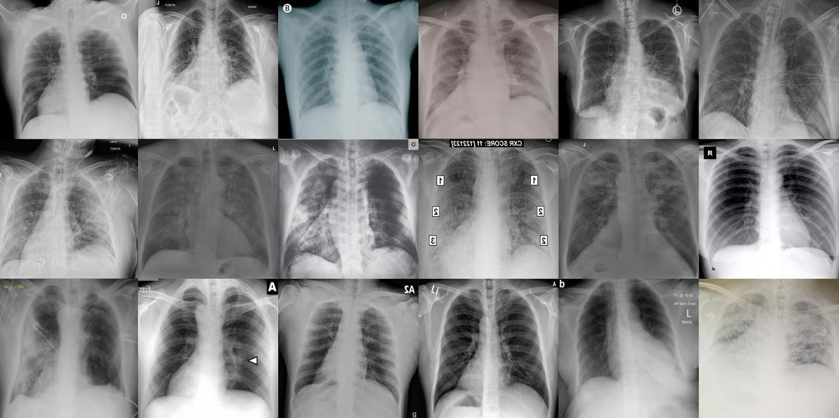



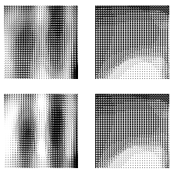
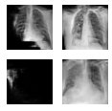
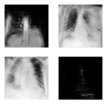
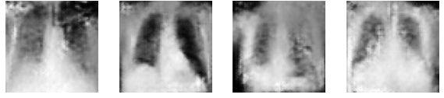
What we did with GANs
Many failed attempts
Target
Grayscale
RGB

Slide 6
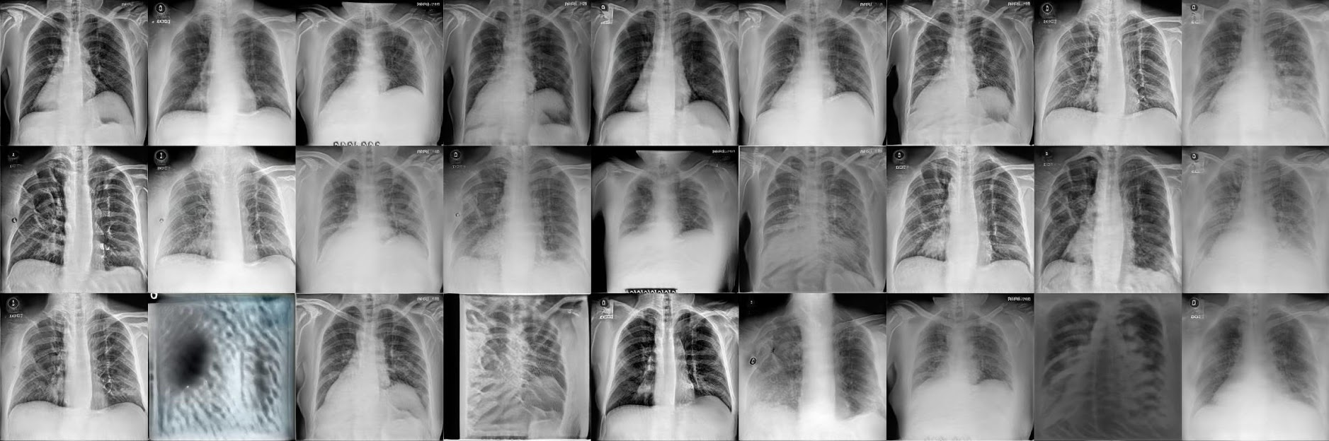
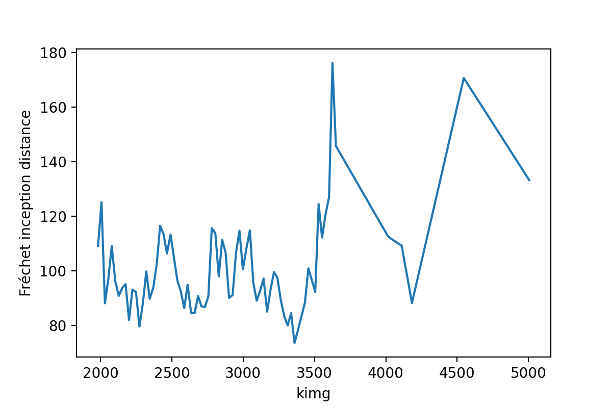
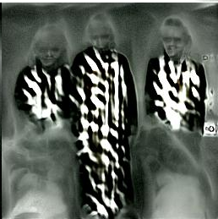
StyleGAN2-ada with transfer learning
Results - Using StyleGAN2-ada and transfer learning
Target
Grayscale
RGB
Training cut off at 3360k img with Fid = 73.471 (Lower is better)
Fun side-note: early transfer learning results from GANs can be horrifying 👻👉
Notes:
State of the art in a popular benchmark proved to be the best option we tried.

Slide 7
Technical details
Alexnet, winner of 2012 ImageNet Challenge (Krizhevsky et al.)
Fine-tuning, 20 epochs, ROC-AUC
3 models:
Original data (Base case)
Simple Augmentations (rotations, affine transformation, centercropping, horizontal flips)
GAN augmented dataset (7000 generated Covid-19 images)
Train/Test provided by Covidx5, further split training set into train/dev sets
Oversample/Undersample for class imbalance
Topcrop, grayscale images in dataset
Notes:
Luca

Slide 8
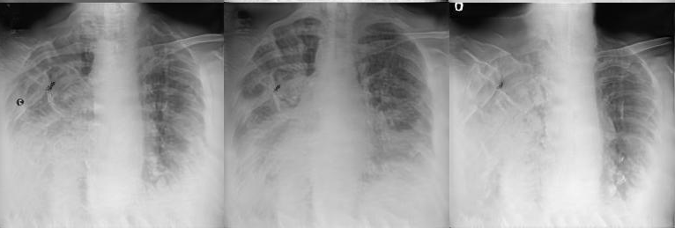
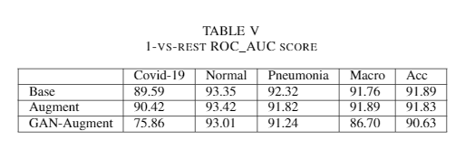
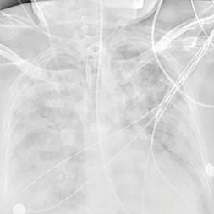
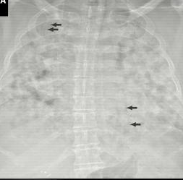
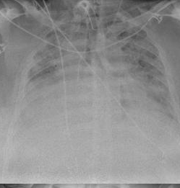
Results/Conclusions
FID score of 73.471 performs worse than baseline
Covid-19 labels misclassified more often as pneumonia
Images not representative of Covid-19
Fake
Real
Notes:
Luca

Slide 9
Reflection
What we tried to do:
Use FID score as indication of GAN quality, analysis of generated images
What we can do in the future:
Try to improve FID score of 73.471
Explore StyleGan2 in more detail
Experiment with different hyperparameters
Train from scratch
Use Conditional GANs (Mirza et al., 2014)

Slide 10
Questions?
Suggestions?

Slide 11
References
Frid-Adar, Maayan, et al. "GAN-based synthetic medical image augmentation for increased CNN performance in liver lesion classification." Neurocomputing 321 (2018): 321-331.
Loey, Mohamed, Florentin Smarandache, and Nour Eldeen M Khalifa. "Within the lack of chest COVID-19 X-ray dataset: a novel detection model based on GAN and deep transfer learning." Symmetry 12.4 (2020): 651.
Waheed, Abdul, et al. "Covidgan: data augmentation using auxiliary classifier gan for improved covid-19 detection." Ieee Access 8 (2020): 91916-91923.
Zulkifley, Mohd Asyraf, Siti Raihanah Abdani, and Nuraisyah Hani Zulkifley. "COVID-19 Screening Using a Lightweight Convolutional Neural Network with Generative Adversarial Network Data Augmentation." Symmetry 12.9 (2020): 1530.
Krizhevsky, Alex, Ilya Sutskever, and Geoffrey E. Hinton. "Imagenet classification with deep convolutional neural networks." Advances in neural information processing systems 25 (2012): 1097-1105.

